Slide 1
Knowledge Modeling and Knowledge Management
Lecture 2 - Knowledge Modeling and Representation
Prof. Li Yao
Spring 2019, Li Yao

Slide 2
Topics
Tacit and Explicit Knowledge
Overview of Conceptual Modeling
Knowledge Representation Language
Knowledge Modeling using FOL
Satisfiability and Axiomatizability Theorems
Spring 2019, Li Yao

Slide 3
Tacit and explicit knowledge
There are two types of knowledge:
Tacit knowledge is embedded in the human brain, and cannot expressed easily
Explicit knowledge can be easily codified
[Nonaka, 1994]
Spring 2019, Li Yao
Notes:
The 80/20 rule appears to apply here; that is, roughly 80% of our knowledge
is in tacit form as individuals, as groups, and as an organization. Only
15 to 20% of valuable knowledge has typically been captured, codified, or rendered
tangible and concrete in some fashion.

Slide 4
Tacit knowledge
Tacit knowledge is mental (mental schemata, beliefs, images, personal points of view and perspectives, concrete know-how e.g. reflexes, personal experience, etc.).
Characteristics of tacit knowledge
  Personal
  Context specific
  Subjective
  Experience based knowledge,
  It includes cognitive skills such as intuition as well as technical skills such as craft and know-how.
  hard to formalise
  hard to communicate
Spring 2019, Li Yao
Notes:
The concept of tacit knowledge, as we saw in Chapter 1, has been clarified
by Polanyi (1966), who stresses the importance of the “personal” way of
knowledge construction, affected by emotions and acquired at the end of the
process involving every individual’s active creation and organization of the
experiences.

Slide 5
Explicit knowledge
Explicit knowledge, is formalised, coded in a language natural (French, English, etc.) or artificial (UML, mathematics, etc.) and can be transmitted.
Characteristics of explicit knowledge
  objective
  rational knowledge that can be expressed in words, sentences, numbers or formulas.
  It includes theoretical approaches, problem solving, manuals and databases.
Spring 2019, Li Yao

Slide 6
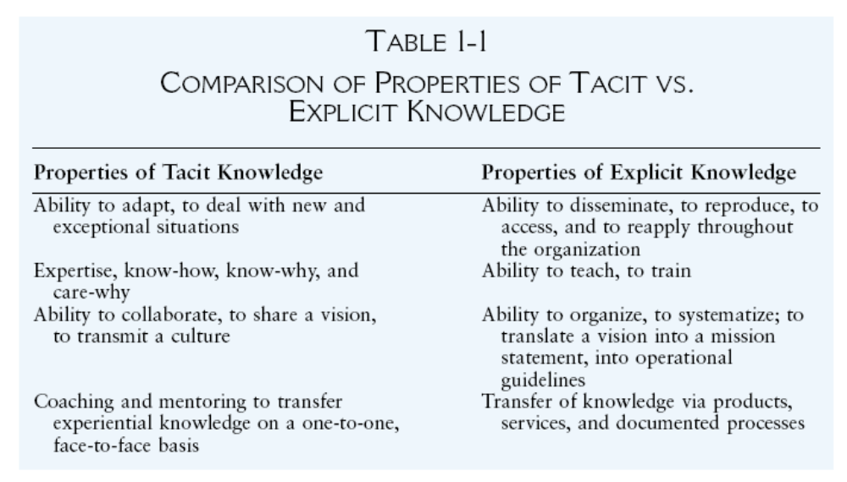
Tacit vs. explicit knowledge
Spring 2019, Li Yao

Slide 7
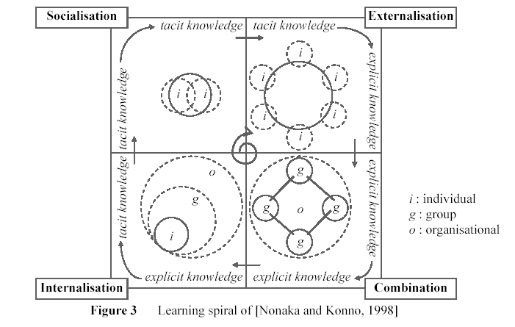
Knowledge Evolution Process
Spring 2019, Li Yao
Notes:
The two steps in the knowledge spiral that are the most difficult are those
involving a change in the type of knowledge, namely, externalization, which
converts tacit into explicit knowledge, and internalization, which converts explicit into tacit knowledge. These two steps require a high degree of personal commitment, and they will typically involve mental models, personal beliefs and values, and a process of reinventing yourself, your group, and the organization as a whole.

Slide 8
Topics
Tacit and Explicit Knowledge
Overview of Conceptual Modeling
Knowledge Representation Language
Knowledge Modeling
Satisfiability and Axiomatizability Theorems
Spring 2019, Li Yao

Slide 9
Information Modeling
In general, we are interested in models of information (about the world.) The information may come from a single agent, or a group of agents.
“information modeling” means “models of information”.
[John Mylopoulos 2004]
Spring 2019, Li Yao

Slide 10
Origins
Ross Quillian proposed semantic networks as a model of the structure of human memory (1966)
Ole-Johan Dahl proposed in 1967 Simula, an extension of the programming language ALGOL 60, for simulation applications which require some “world modeling”
Jean-Robert Abrial proposed a semantic model in 1974, shortly followed by Peter Chen’s Entity-Relationship model (1975) as advances over logical data models, such as Codd’s Relational model.
Doug Ross proposed in the mid-70s the Structured Analysis and Design Technique (SADT) as a “language for communicating ideas”. The technique was used to specify requirements for software systems.
[John Mylopoulos 2004]
Spring 2019, Li Yao

Slide 11
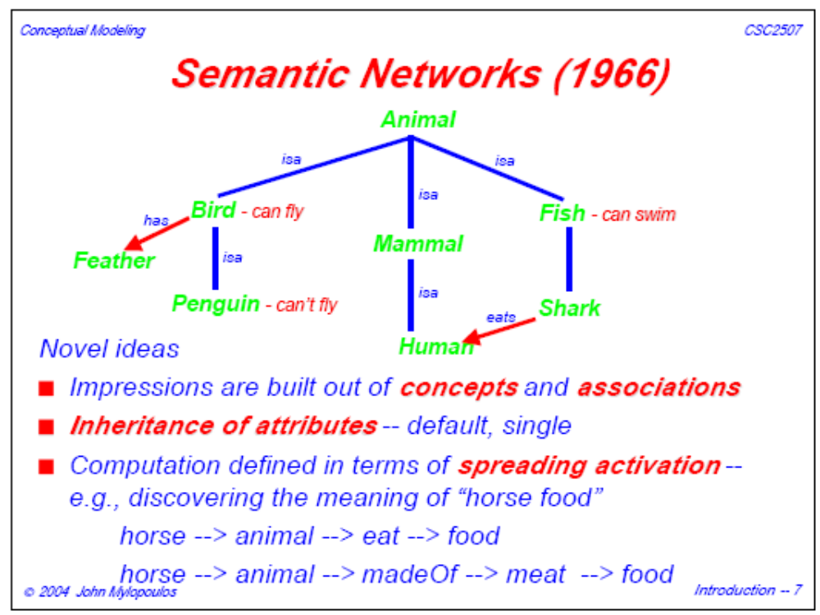
[John Mylopoulos 2004]
Spring 2019, Li Yao

Slide 12
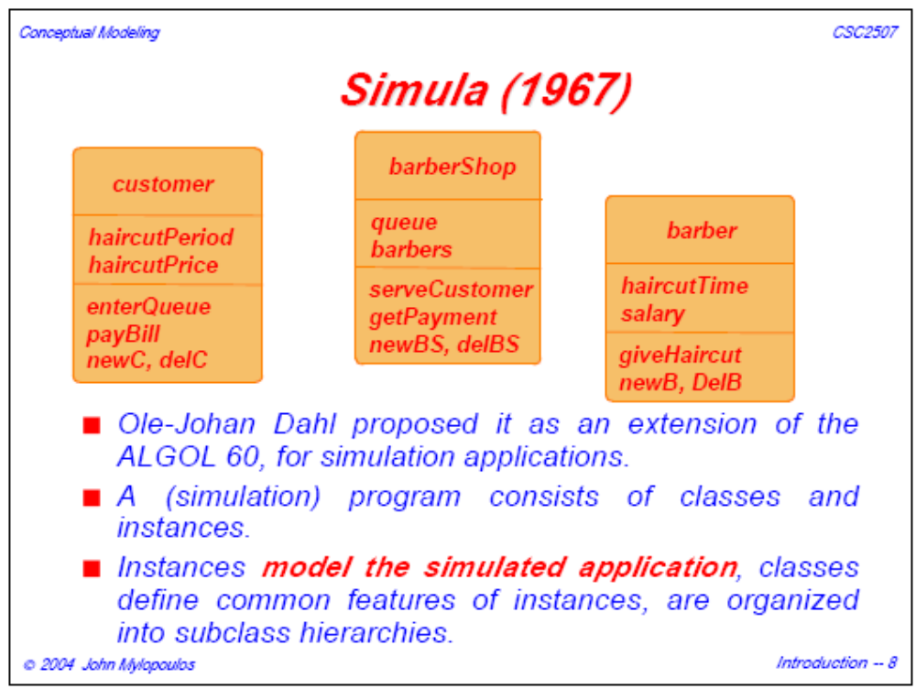
[John Mylopoulos 2004]
Spring 2019, Li Yao

Slide 13
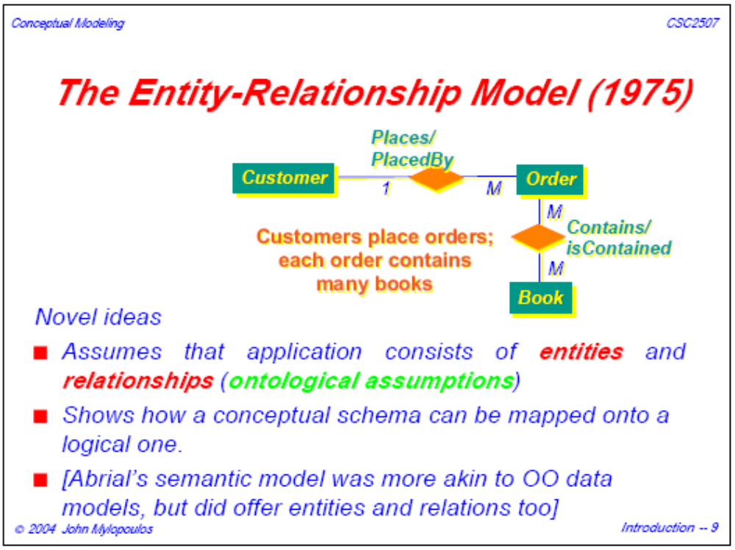
[John Mylopoulos 2004]
Spring 2019, Li Yao

Slide 14
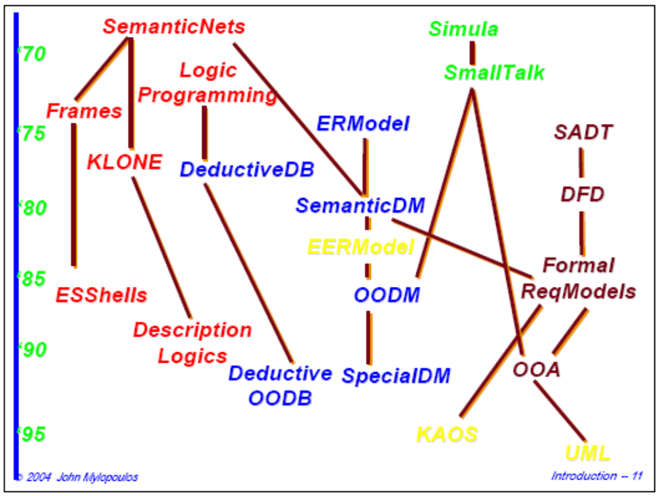
[John Mylopoulos 2004]
Spring 2019, Li Yao

Slide 15
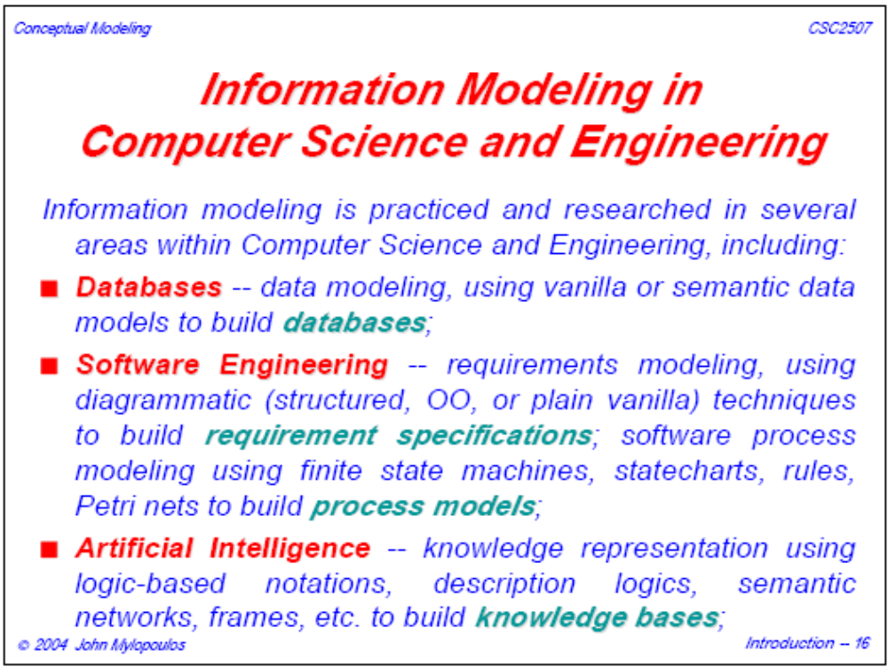
[John Mylopoulos 2004]
Spring 2019, Li Yao

Slide 16
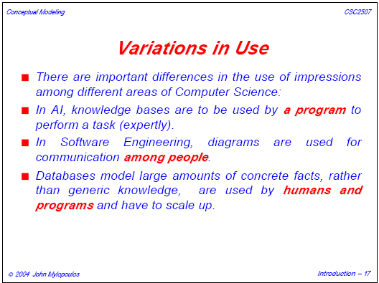
[John Mylopoulos 2004]
Spring 2019, Li Yao

Slide 17
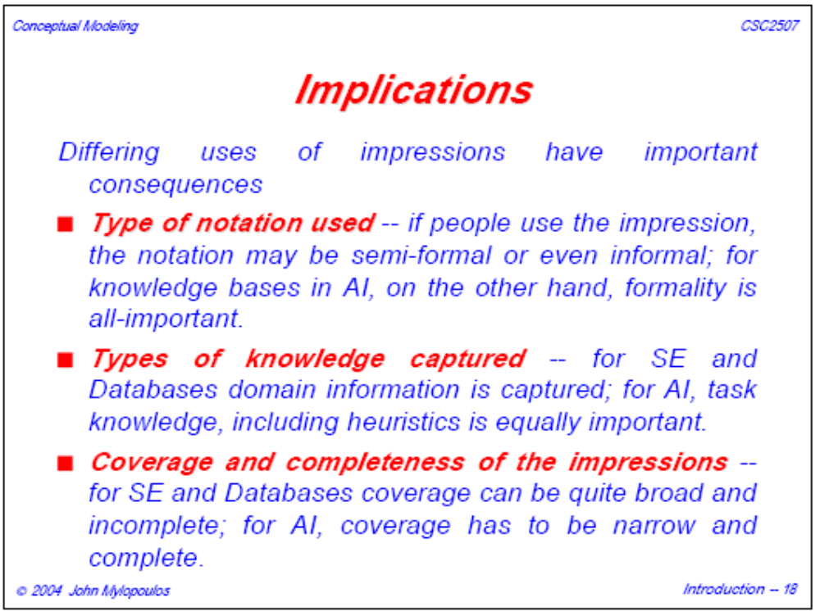
[John Mylopoulos 2004]
Spring 2019, Li Yao

Slide 18
Topics
Tacit and Explicit Knowledge
Overview of Conceptual Modeling
Knowledge Representation Language
Knowledge Modeling using FOL
Satisfiability and Axiomatizability Theorems
Spring 2019, Li Yao

Slide 19
Knowledge Modeling
Knowledge modeling is intended for anyone whose job to analyze knowledge about the read world and map it to a computable form.
We are interested in models of knowledge about an organization (e.g. enterprise).
Spring 2019, Li Yao

Slide 20
Logic, Ontology, and Computation
Knowledge representation is a multidisciplinary subject that applies theories and techniques from three other fields:
Logic provides the formal structure and rules of inference.
Ontology defines the kinds of things that exist in the application domain.
Computation supports the applications that distinguish knowledge representation from pure philosophy.
Spring 2019, Li Yao
Notes:
1) Without Logic, a knowledge representation is vague, with no criteria for determining whether statements are redundant or contradictory.
2) Without Ontology, the terms and symbols are ill-defined, confused, and comfusing.
3) Without Computable model, the logic and ontology cannot be implemented in computer programs.

Slide 21
Knowledge Modeling
Knowledge Modeling is the application of logic and ontology to the task of constructing computable models for some domain.
Spring 2019, Li Yao

Slide 22
Knowledge Representation Language
Before building an knowledge-based system which can be learning, reasoning, planning, explanation ...
We need to be able to express knowledge using an language
The language is supposed to be a precise declarative language
Spring 2019, Li Yao

Slide 23
A Formal Language
Syntax: which groups of symbols, arranged in what way, are to be considered properly formed.
Semantics: what the well-formed expressions are supposed to mean.
Pragmatics: how the meaningful expressions in the language are to be used.
Spring 2019, Li Yao

Slide 24
Some KR Languages
Language based on First Order Logic
  CommonLisp
  KIF
Language based on Horn Logic
  Prolog
  SWRL
Language based on Description Logics
  OWL-DL
  OWL-LITE
Spring 2019, Li Yao

Slide 25
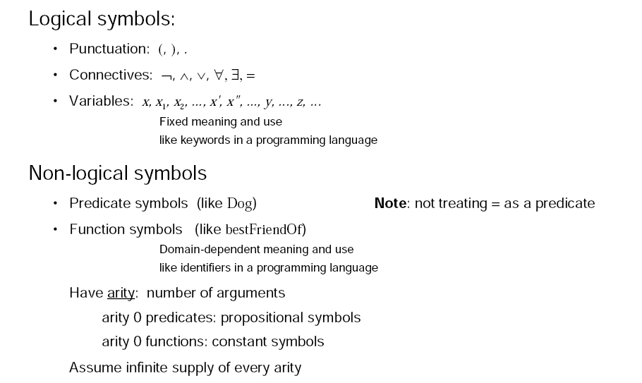
language of first-order logic
Spring 2019, Li Yao

Slide 26



FOL语法（1）
一阶逻辑语言中有两种类型的合法表达式：项（Term）和公式（Formula），其中，项代表了论域中的个体；公式表示了论域中的一个命题。
一阶逻辑语言中项的形成规则如下。
  每一个变量是项。
  如果 为n元函数， 均为项，则 是项。
Spring 2019, Li Yao

Slide 27




FOL语法（2）
一阶逻辑语言中公式的形成规则如下：
  （1）如果 为 n元谓词， 均为项，则
  是公式。
  （2）如果 为项，则 是公式。
  （3）如果α和β为公式， 是项，则 ¬α, α∧β，α ∨ β，
  ∀xα，∃ xα 均为公式。
形成规则（1）和（2）形成的公式称为原子公式
在形成规则（3）中，如果公式中有些变量未被量词“∀”或“∃”约束，则称这些变量为自由变量
当省略括号时，“∧”的运算优先级高于“∨”。
Spring 2019, Li Yao

Slide 28
OWL Syntax & Semantics （1）
构造算子 | 语法 | 语义 | 例子
原子概念 | A | A^{I} ⊆ △^{I} | Human
原子关系 | R | R^{I} ⊆△^{I} × △^{I} | has-child
对概念C,D和关系(role)R
合取 | C⊓ D | C^{I}∩ D^{I} | Human ⊓ Male
析取 | C⊔ D | C^{I} ⋃ D^{I} | Doctor ⊔ Lawyer
非 | ¬ C | △^{I} \C | ¬ Male
存在量词 | ∃ R.C | {x| ∃ y.<x,y>∈ R^{I}∧y ∈ C^{I}} | ∃ has-child.Male
全称量词 | ∀ R.C | {x| ∀ y.<x,y>∈ R^{I} ⇒ y ∈ C^{I}} | ∀ has-child.Doctor
Spring 2019, Li Yao

Slide 29
OWL Syntax & Semantics （2）
构造算子 | 语法 | 语义 | 例子
数量约束 | ≥n R . C | {x| | {y|<x,y>∈ R^{I} ,y ∈ C^{I}} | ≥n} | ≥3 has-child .Male
 | ≤ n R . C | {x| | {y|<x,y>∈ R^{I} ,y ∈ C^{I}} | ≤ n} | ≤ 3 has-child .Male
逆 | R ⁻ | {<y,x>|<x,y>∈ R^{I} } | has-child⁻
传递闭包 | R* | (R^{I} )* | has-child*
两个类似于FOL中的全集(true)和空集(false)的算子
top | T | △^{I} | Male ⊔ ¬ Male
Bottom | ⊥ | ∅ | Man ⊓ ¬ Man
Spring 2019, Li Yao

Slide 30
SWRL
SWRL（Semantic Web Rule Language）
Rule： antecedent ⇒ consequent
where both antecedent and consequent are conjunctions of atoms written a₁ ∧ ... ∧ a_{n}. Variables are indicated using the standard convention of prefixing them with a question mark (e.g., ?x).
E.g.
parent(?x,?y) ∧ brother(?y,?z) ⇒ uncle(?x,?z)
Spring 2019, Li Yao

Slide 31
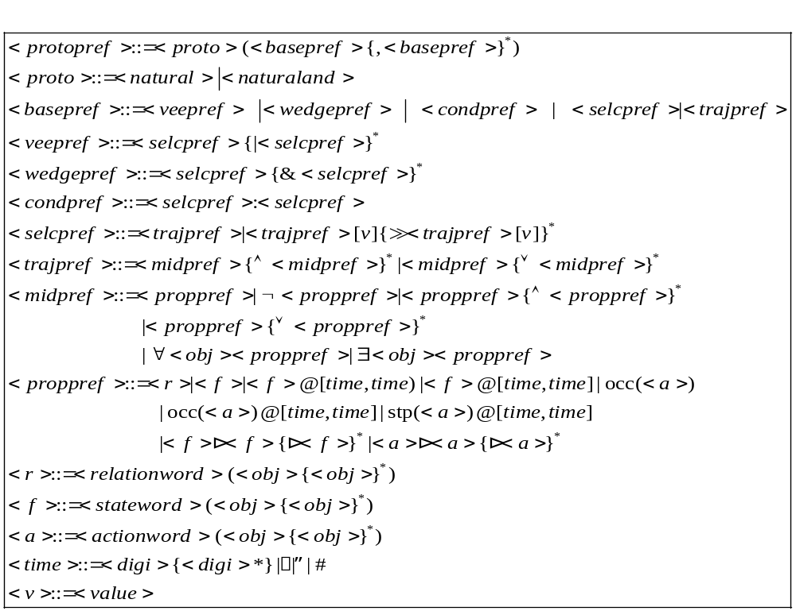
时态规划偏好表示语言（Temporal Planning Preference Language，TPPL）
Spring 2019, Li Yao
Notes:
语言规范可使用巴科斯-诺尔范式（Backus-Naur Form，BNF）进行描述。

Slide 32





SmartQuery本体查询语言（1）
（2）概念特性原子查询：查询概念特性H的取值为v 的虚拟对象集
（3）角色原子查询：查询符合角色约束的虚拟对象集
Spring 2019, Li Yao

Slide 33
SmartQuery本体查询语言
（5）合取查询的并（UCQ）：对应关系数据库中SPJU查询
（6）布尔查询：不返回查询结果集，仅返回true或者false
Spring 2019, Li Yao

Slide 34
Topics
Tacit and Explicit Knowledge
Overview of Conceptual Modeling
Knowledge Representation Language
Knowledge Modeling using FOL
Satisfiability and Axiomatizability Theorems
Spring 2019, Li Yao

Slide 35
Formal Theory
1. Language
  Syntax: which groups of symbols, arranged in what way, are to be considered properly formed.
  Semantics: what the well-formed expressions are supposed to mean.
  Pragmatics: how the meaningful expressions in the language are to be used.
2. Foundational Theories
  A set of distinguished predicates
  A set of distinguished functions
  Axiomatic systems
Spring 2019, Li Yao
Notes:
We need to specify

Slide 36
language of first-order logic
Spring 2019, Li Yao

Slide 37
Expressing Knowledge
Vocabulary
Basic Facts
Complex Facts
Terminological Facts
Entailments
Spring 2019, Li Yao

Slide 38
Expressing Knowledge
Vocabulary
Basic Facts
Complex Facts
Terminological Facts
Entailments
Spring 2019, Li Yao

Slide 39
Expressing Knowledge: Vocabulary
The syntax of FOL is limited
The set of named individuals
  Constant （e.g. MaryJones）
Types of objects
  One-place predict (e.g. Person (x))
The set of attributes
  One-place predict (e.g. Beautiful (x))
Relationships
  N-ary predict (e.g. MarriedTo (x, y))
  function (e.g. bestFriendOf (x))
All functions are taken to be total in FOL.
Spring 2019, Li Yao
Notes:
The syntax of FOL is limited in that it does not allow us to distinguish between properties and the object types.

Slide 40



Model and its Vocabulary
Spring 2019, Li Yao

Slide 41
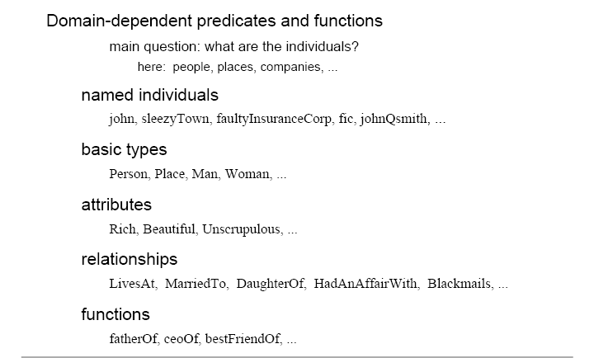
Soap-Opera World: Vocabulary
Spring 2019, Li Yao

Slide 42
Expressing Knowledge: Basic Facts
The simple core facts
  Atomic sentence
  (e.g. Woman (MaryJones))
  Negation of atomic sentence
  (e.g. ¬ Man (MaryJones))
The close world assumption
  Type facts
  Property facts
  Equality facts
Spring 2019, Li Yao

Slide 43
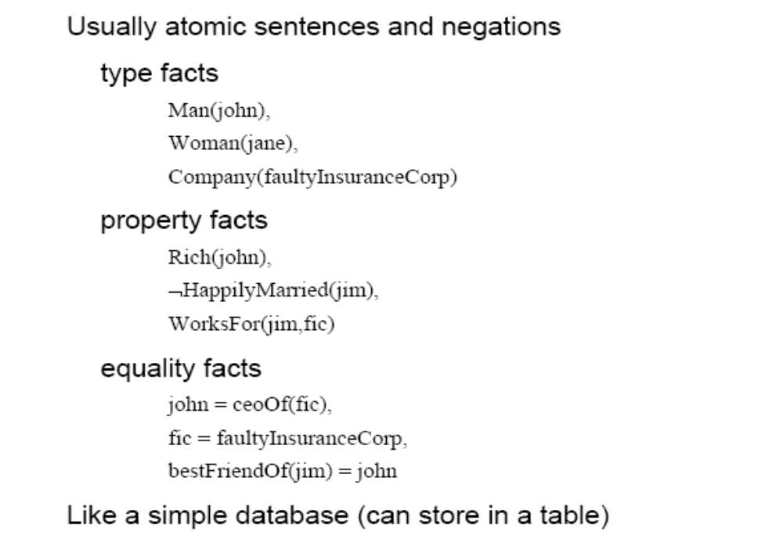
Soap-Opera World: Basic facts
Spring 2019, Li Yao

Slide 44
Expressing Knowledge: Complex Facts
Complex formulas with quantifiers(∀,∃) and other connectives(¬,∧,∨ ,⊃, ≡)
  e.g. ∀y[ Rich (y) ∧ Man (y) ⊃ Loves (y, MaryJone) ]
  Universals abbreviations
  Incomplete knowledge
  Close axisms
Spring 2019, Li Yao

Slide 45
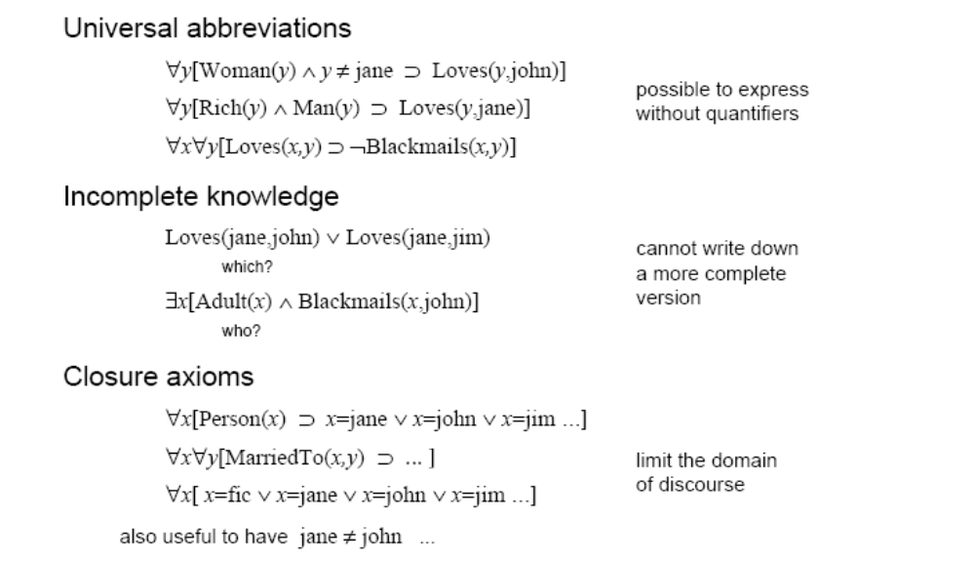
Soap-Opera World: Complex facts
Spring 2019, Li Yao

Slide 46
Expressing Knowledge: Terminological Facts
Terminological facts come in many varieties(1)
Disjointness
  e.g. ∀x[ Man (x) ⊃ ¬Woman (x)]
Subtypes
  e.g. ∀x[ Surgeon (x) ⊃ Doctor (x)]
Exhaustiveness
  e.g. ∀x[ Adult (x) ⊃ (Man (x) ∨Woman (x))]
Symmetry
  e.g. ∀x, y[ MarriedTo (x, y) ⊃ MarriedTo (y, x)]
Spring 2019, Li Yao

Slide 47
Expressing Knowledge: Terminological Facts
Terminological facts come in many varieties(2)
Inverses
  e.g. ∀x[ ChildOf (x, y) ⊃ ParentOf (y, x)]
Type restrictions
  e.g. ∀x，y [MarriedTo (x, y) ⊃ Person (x)∧ Person (y)]
Full definitions
e.g. ∀x [ RichMan (x) ≡ Rich (x) ∧ Man (x)]
Spring 2019, Li Yao

Slide 48
Entailments
We can reason about the meaning of the terminology of the theories using structures which satisfy the axioms.
Let us consider all of the facts to be a knowledge base, called KB.
Deriving implicit conclusions from our explicitly represented KB
Let us imagine an interpretation , and suppose that   KB, then KB  Φ
Spring 2019, Li Yao
Notes:
Now that we have captured the basic structure of our domain.

Slide 49
Soap-Opera World: Vocabulary
Spring 2019, Li Yao

Slide 50
Soap-Opera World: Basic facts
Spring 2019, Li Yao

Slide 51
Soap-Opera World: Complex facts
Spring 2019, Li Yao

Slide 52
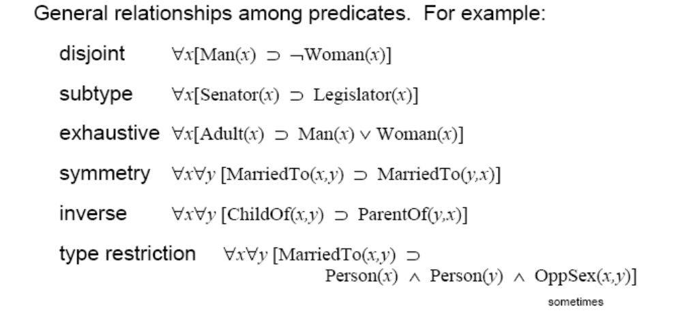
Soap-Opera World: Terminological facts
Spring 2019, Li Yao
Notes:
Senator:参议员；
Legislator：立法委员。

Slide 53
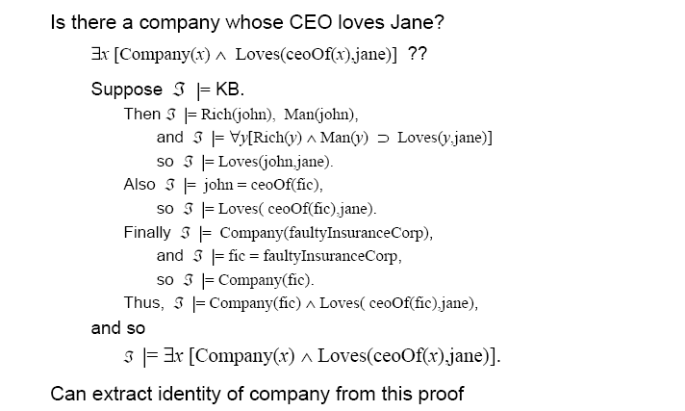
Soap-Opera World: Entailments
Spring 2019, Li Yao

Slide 54
Topics
Tacit and Explicit Knowledge
Overview of Conceptual Modeling
Knowledge Representation Language
Knowledge Modeling using FOL
Satisfiability and Axiomatizability Theorems
Spring 2019, Li Yao

Slide 55
Formal Theory
1. Language
  Syntax: which groups of symbols, arranged in what way, are to be considered properly formed.
  Semantics: what the well-formed expressions are supposed to mean.
  Pragmatics: how the meaningful expressions in the language are to be used.
2. Foundational Theories
  A set of distinguished predicates
  A set of distinguished functions
  Axiomatic systems
Spring 2019, Li Yao
Notes:
We need to specify

Slide 56
First-Order Languages: Syntax
A language is a set of symbols (lexicon) and a specification of how these symbols can be combined to make well-formed formulae (grammar/syntax).
The lexicon consists of logical symbols (such as connectives, variables, and quantifiers) and nonlogical symbols.
Spring 2019, Li Yao
Notes:
For example, in a process ontology, the nonlogical part of the lexicon consists of expressions (constants, functions, predicates) that refer to everything needed to describe processes.

Slide 57
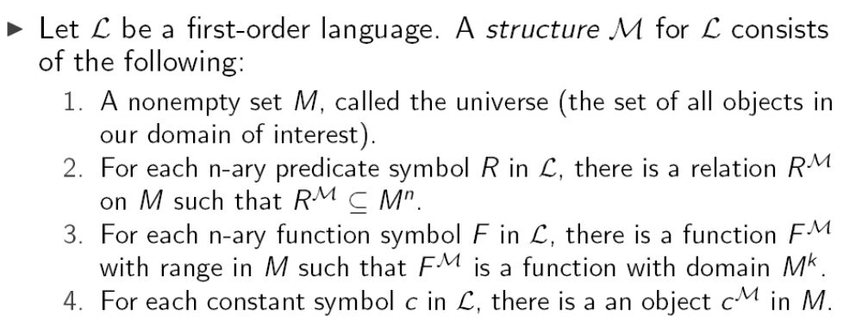
First-Order Languages: Semantics
Spring 2019, Li Yao

Slide 58
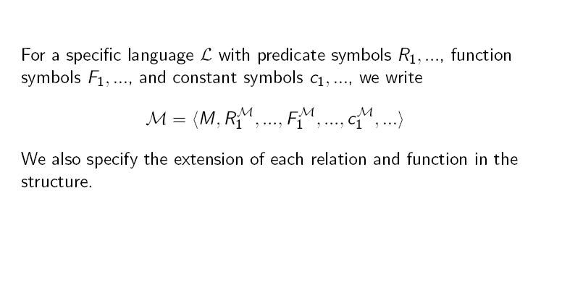
Specifying Structures
Spring 2019, Li Yao

Slide 59
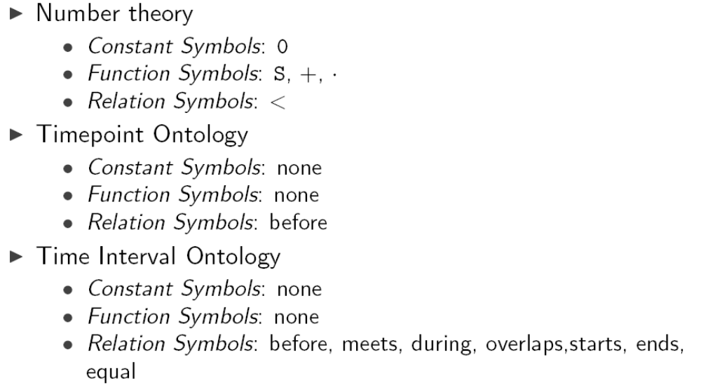
Examples: First-Order Languages
Spring 2019, Li Yao

Slide 60
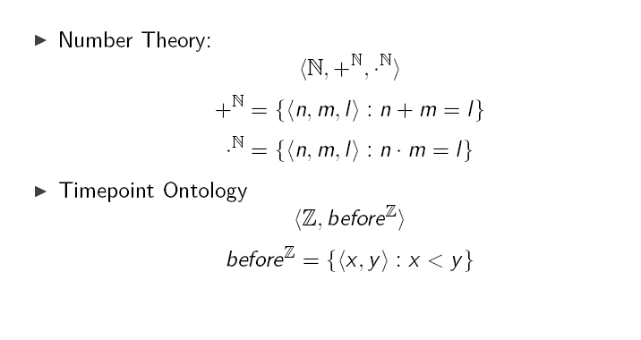
Examples : Structures
Spring 2019, Li Yao

Slide 61
Why Use Structures?
Structures provide a rigorous mathematical characterization of the terminology of the theory.
We can reason about the meaning of the terminology of the theories using structures which satisfy the axioms.
The objective is to identify each term of the theory with an element of some structure. The underlying theory of the mathematical structure then becomes available as a basis for reasoning about the terms of our language and their inter-relationship.
Spring 2019, Li Yao

Slide 62



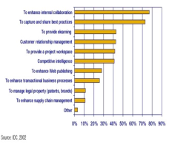
Methodology for the Evaluation of Axiomatic Theories
Intuitions
Structures
Axiomatizability
Satisfiability
Axiomatic theory
Spring 2019, Li Yao

Slide 63
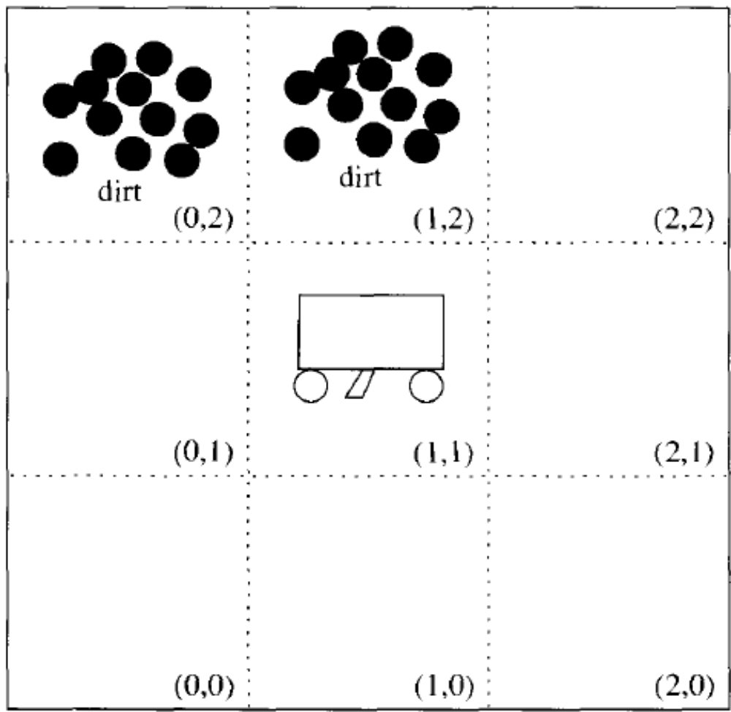
The Vacuum Cleaning World Example
start
Spring 2019, Li Yao

Slide 64
The Vacuum Cleaning Model1
Vocabulary
  Constants : north, south, east, west
  forward, turn,
  Predicates
    In(x,y) agent is at(x,y)
    Facing(d) agent is facing direction d
    Dirt(x,y) location(x,y) is dirt
    Do(f) agent is going to do an action f
Spring 2019, Li Yao

Slide 65
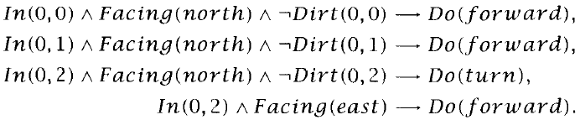
The Vacuum Cleaning Model1
Knowledge Base
Do（forward）
Spring 2019, Li Yao

Slide 66
The Vacuum Cleaning Model2
Vocabulary
  Constants : north, south, east, west
  forward, turn,
  Predicates
    In(x,y) agent is at(x,y)
    Facing(d) agent is facing direction d
    Do(f) agent is going to do an action f
    Walk(x,y) agent can go forward, i.e. there is a position which it has not gone through
Spring 2019, Li Yao

Slide 67
The Vacuum Cleaning Model2
Knowledge Base
  In(x,y) ∧ Facing(north) ∧ walk(x+1,y)→ Do(forward)
  In(x,y) ∧ Facing(east) ∧ walk(x,y+1)→ Do(forward)
  In(x,y) ∧ Facing(south) ∧ walk(x-1,y)→ Do(forward)
  In(x,y) ∧ Facing(west) ∧ walk(x,y-1)→ Do(forward)
  ¬ walk(x+1,y) ∨ ¬ walk(x,y+1) ∨ ¬ walk(x-1,y) ∨ ¬ walk(x,y-1) → Do(turn)
Spring 2019, Li Yao

Slide 68
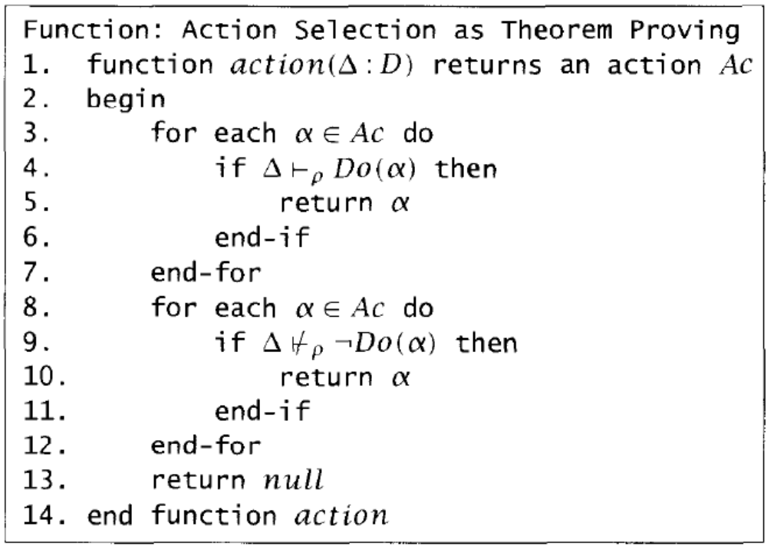
The pseudo-code definition of action function
Spring 2019, Li Yao

Slide 69
Semantics: Intuitions
A universe of discourse is the set of all objects presumed to exist in the world.
Terms are used to denote objects in the world being described; this includes variables, which are used in quantifying over individual objects, and constants, that are used to denote individual objects.
For every set of objects, a function associates a unique object.
For every set of objects, a relation associates a truth value; the set of objects that evaluate to true specifies the objects that satisfy the relation.
Spring 2019, Li Yao

Slide 70

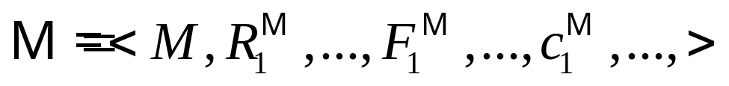

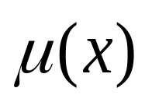
一阶逻辑语言的语义
设☹为一阶逻辑语言，☹的一个结构定义为
为了处理包括变元的项，我们还需要在论域M上定义一个变量赋值μ，说明子句中的变量映射到论域M中的元素。也即，若μ为一个变量赋值， 为一个变量，则 表示论域M中的某个元素。
Spring 2019, Li Yao

Slide 71
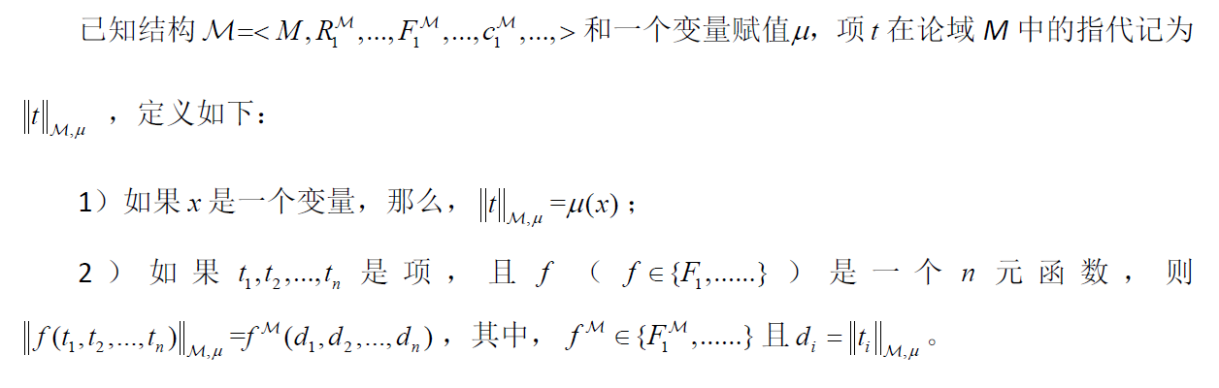
项的语义
Spring 2019, Li Yao

Slide 72
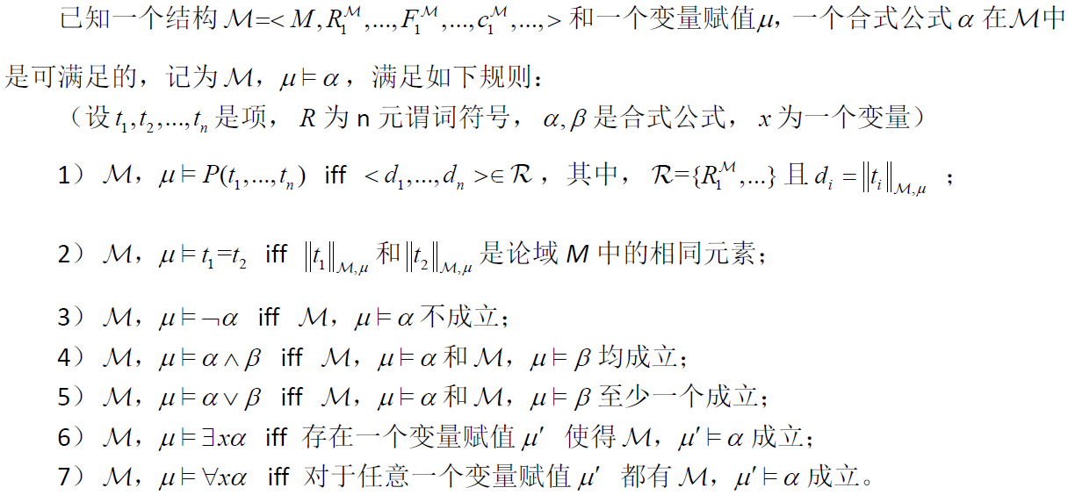

合式公式的语义
Spring 2019, Li Yao

Slide 73
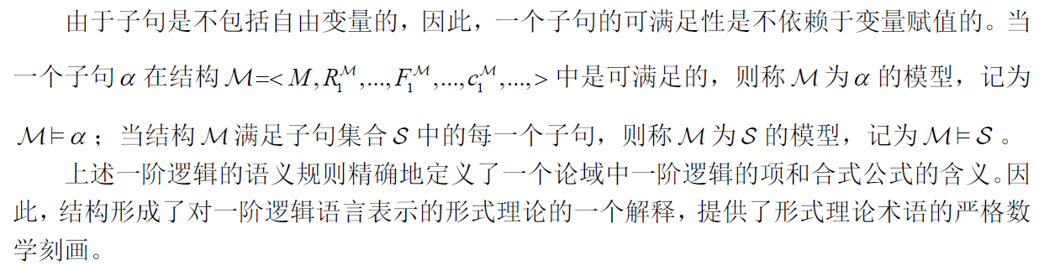
模型论语义
Spring 2019, Li Yao

Slide 74
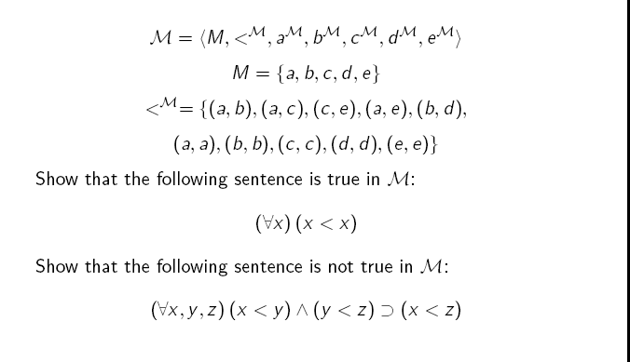
Truth in a Structure: Example
Spring 2019, Li Yao

Slide 75
一阶逻辑语言的语用
由于一阶语言表示的形式理论中的每一个项都对应结构中的一个元素，每一个合式公式都对应结构中的一个命题，因此，对数学结构所基于的形式理论的推导，就可获得结构应满足的关系。
一阶逻辑语言的语用正是研究如何使用语言来表示知识，以使所构造的形式理论能够推导出实际应用所需的逻辑结论，并且保证所推导的结论是正确的和完备的。
Spring 2019, Li Yao

Slide 76
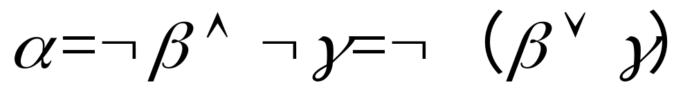
逻辑推导与逻辑蕴含的关系
从一阶逻辑语言的语义规则可见：
尽管形式理论 的一个解释（即结构 ）是依赖于非逻辑符号的，但形式理论 中的一个子句的真值仅依赖于合式公式之间的逻辑关联，并不依赖于非逻辑符号表示的实际含义。
例如，
Spring 2019, Li Yao

Slide 77
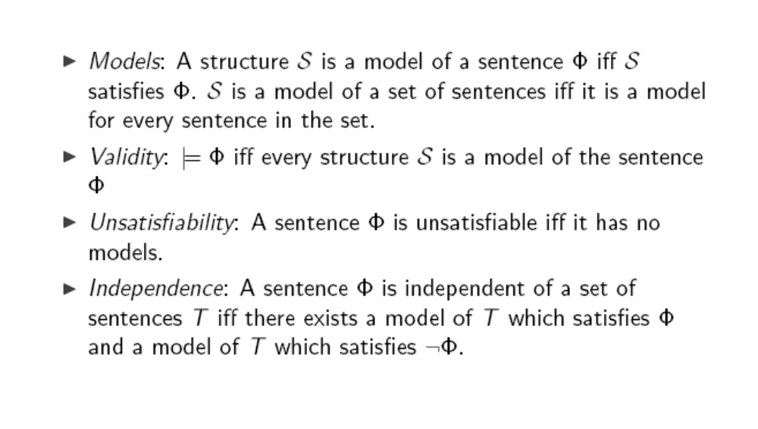
Models and Axioms
Spring 2019, Li Yao
Notes:
Validity：合法的；正确的

Slide 78
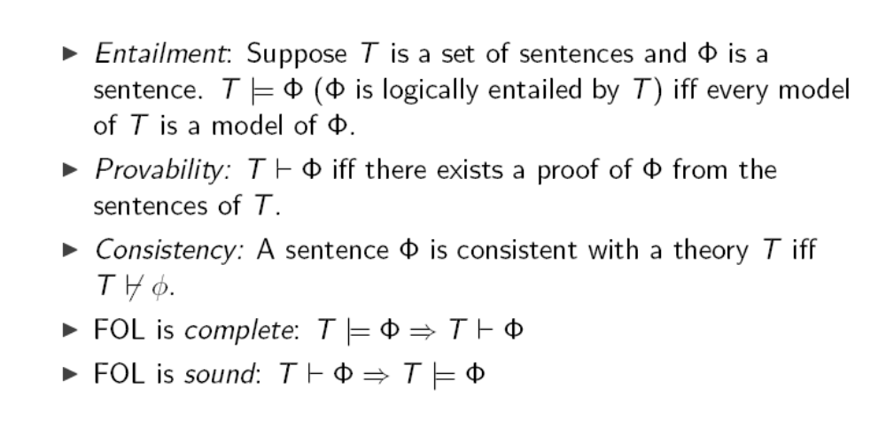
Metatheory

Spring 2019, Li Yao
Notes:
Entailment vs. inference

Slide 79
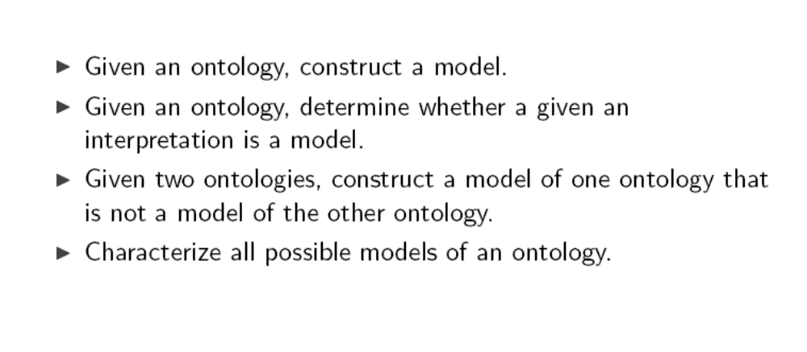
Typical Results
Spring 2019, Li Yao

Slide 80
Characterization Theorems
We can evaluate the adequacy of the application’s ontology with respect to some class of structures that capture the intended meanings of the ontology’s terms by proving that the ontology has the following two fundamental properties:
Satisfiability: every structure in the class is a model of the ontology.
Axiomatizability: every model of the ontology is isomorphic to some structure in the class.
Spring 2019, Li Yao
Notes:
isomorphic
[7aisEu5mC:fik]
adj.
同形的, [数]同构的

Slide 81
Axioms and Model Theory
A set of axioms can give different interpretation, but one of these will be the intended interpretation that guided the development of the axioms.
The axiomatization allows a characterization of these interpretations.
We can reason about the semantics of the terminologies of the ontologies using the models of the axioms in the foundational theories.
Spring 2019, Li Yao

Slide 82
Model-Theoretic Approach
Intuitions
Models
Structures
Satisfiability
Axiomatizability
Axioms
Axiomatic theory
Spring 2019, Li Yao

Slide 83
Model-Theoretic Approach
Providing a formalization of the notion of motivating scenarios
Assisting in the development of axioms for terminology
Evaluating an ontology using counterexamples.
Spring 2019, Li Yao

Slide 84
Satisfiability Theorem
Strictly speaking, we only need to show that a model exists in order to demonstrate that a theory is satisfiable. However, in the axiomatization of domain theories, we need a complete characterization of the possible models.
The problem with this approach is that we run the risk of having demonstrated satisfiability only for some restricted class of activities.
Spring 2019, Li Yao

Slide 85
Methodology for the Evaluation of Axiomatic Theories
Intuitions
Structures
Axiomatizability
Satisfiability
Axiomatic theory
Spring 2019, Li Yao

